Slide 1
EMBEDDED SYSTEM
Notes:
The AVR is a modified Harvard architecture machine. ATMEGA is the member of AVR family manufactured by ATMEL.
Microchip Technology agreed to acquire a fellow chipmaker, the Atmel Corporation in 2016

Slide 2
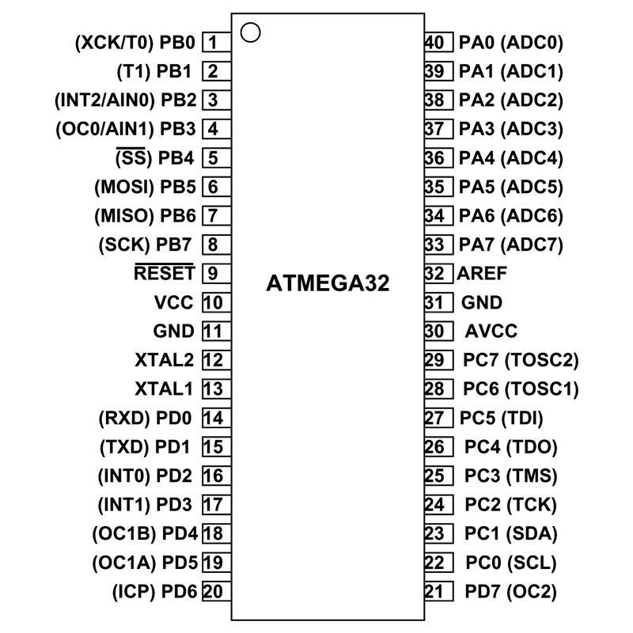

Slide 3
Analog to Digital Conversion
ATMEGA32 ADC Features:
10-bit
8 input channels
Converted data his held in tow special registers ADCL and ADCH
ADCH:ADCL is 16 bits; ADC data 10-bits; 6 bits are unused
Option of making either upper 6 bits or lower 6 bits unused
Three options for Vref; Vref🡪AVCC, Vref🡪internal 2.56V, Vref🡪external AREF pin
Notes:
Dout = Vin/step size ; step size = Vref/2^n ; n is # of bits of ADC
ADCL🡪 A/D result Low; ADCH-🡪 A/D result High

Slide 4
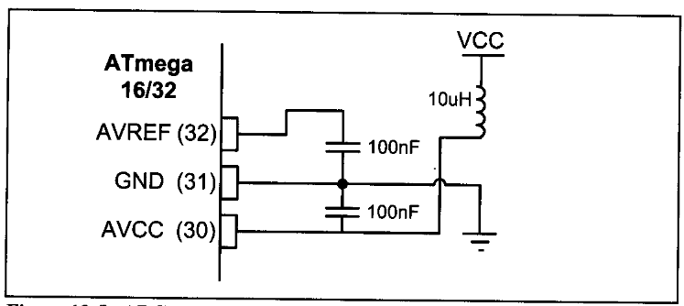
Analog to Digital Conversion
Connection for ADC: Following connection provide stable VCC and Vref
Notes:
In place of inductor a resistance can be added.

Slide 5
ADC Registers
Five major registers associated
ADCH (High data)
ADCL (Low data)
ADCSRA (ADC control and status register)
ADMUX (ADC multiplexer selection register)
SPIOR (Special function I/O register)

Slide 6
ADMUX Registers
REFS1 | REFS0 | ADLAR | MUX4 | MUX3 | MUX2 | MUX1 | MUX0
REFS1:0 Bit 7:8 Reference selection bits
Reference voltage for ADC
REFS1 | REFS0 | Vref
0 | 0 | AREF pin | Set externally
0 | 1 | AVCC pin | Same as VCC
1 | 0 | Reserved | -------
1 | 1 | Internal 2.56 V | Fixed regardless of VCC value

Slide 7
ADMUX Registers
REFS1 | REFS0 | ADLAR | MUX4 | MUX3 | MUX2 | MUX1 | MUX0
ADLAR Bit 5 ADC left adjust result
ADLAR = 1🡪Left adjusted ; ADLAR = 0🡪 Right Adjusted ; ADCH:ADCL
ADCH
ADCL
D9 | D8 | D7 | D6 | D5 | D4 | D3 | D2
D1 | D0 | X | X | X | X | X | X
ADLAR = 1
X | X | X | X | X | X | D9 | D8
D7 | D6 | D5 | D4 | D3 | D2 | D1 | D0
ADLAR = 0

Slide 8
ADMUX Registers
REFS1 | REFS0 | ADLAR | MUX4 | MUX3 | MUX2 | MUX1 | MUX0
MUX4:0 Bit 4:0 Analog channel and Gain selection bits
Gain for diff. channel; Combination of analog I/P connected to ADC
MUX 4…0 | Single ended Input
00000 | ADC0
00001 | ADC1
00010 | ADC2
00011 | ADC3
MUX 4…0 | Single ended Input
00100 | ADC4
00101 | ADC5
00110 | ADC6
00111 | ADC7
Notes:
Wewill not use Differential ADC;

Slide 9
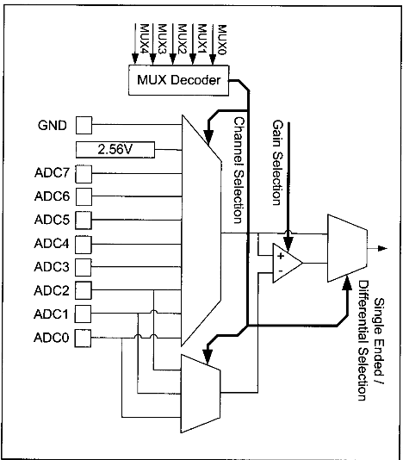

Slide 10
ADCSRA Registers
ADEN | ADSC | ADATE | ADIF | ADIE | ADPS2 | ADPS1 | ADPS0
ADEN Bit 7 ADC enable
ADEN = 1 🡪 Enable ADC; ADEN = 0 🡪 Disable ADC
ADSC Bit 6 ADC Start conversion
ADSC = 1 🡪 Start conversion; ADSC = 0 🡪 Stop conversion
ADATE Bit 5 ADC Auto trigger enable
ADATE = 1 🡪 Auto trigger
Notes:
Wewill not use Differential ADC;

Slide 11
ADCSRA Registers
ADEN | ADSC | ADATE | ADIF | ADIE | ADPS2 | ADPS1 | ADPS0
ADIF Bit 4 ADC interrupt flag
ADC sets ADIF = 1 when conversion is completed
ADIE Bit 3 ADC interrupt enable
Setting ADIE = 1 enables the ADC conversion complete interrupt
ADSP2:0 Bit 2:0 ADC pre-scaler select bits
Determine the division factor b/w XTAL frequency and input clock to ADC
Notes:
Wewill not use Differential ADC;

Slide 12
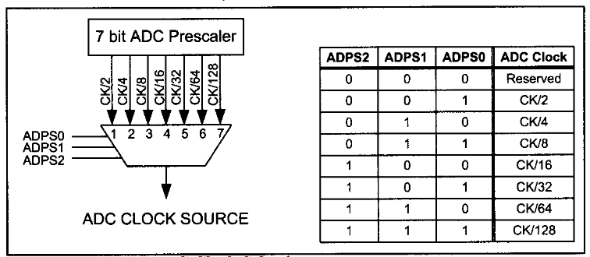
ADCSRA Registers
ADEN | ADSC | ADATE | ADIF | ADIE | ADPS2 | ADPS1 | ADPS0
ADSP2:0 Bit 2:0 ADC pre-scaler select bits
Determine the division factor b/w XTAL frequency and input clock to ADC
Notes:
Wewill not use Differential ADC;

Slide 13
Programming A/D Converter
Two methods of using ADC
Polling method
Interrupt method
Steps for polling method
Make pin for selected ADC channel as input pin
Turn on the ADC module because it is disabled by default
Select conversion speed; ADPS2:0
Notes:
Wewill not use Differential ADC;

Slide 14
Programming A/D Converter
4. Select voltage reference and ADC input channel
Voltage reference : REFS0 and REFS1 bit in ADMUX
ADC input channel: MUX4:0 bits in ADMUX
5. Activate Start conversion 🡪 ADSC = 1 of ADCSRA
6. Wait for conversion to complete by polling ADIF bit of ADCSRA
7. When ADIF = 1 🡪 Read ADCL and ADCH
Read ADCL before ADCH otherwise result will not be valid
Notes:
Wewill not use Differential ADC;

Slide 15
Programming A/D Converter
/*-------------------------------------------------------------------------------------------------------------
*Frequency of Operation = 8Mhz -->> 125ns one instruction
*while ADC takes 25 ADC cycle in first conversion and after that it will take 13 ADC clock cycle
*ADC prescaller is 128-->> 8MHz/128 = 62.5KHz
*1 ADC clock cycle = 16 us
*1 conversion takes minimum 400us
*---------------------------------------------------------------------------------------------------------------*/
.INCLUDE "M32DEF.INC« ;ADD Atmega32 definition
.ORG 00;Origin at 0x00
;--------------------------------------------------------------------------------------------------------
LDI R16, 0x00 ; define portA input
OUT DDRA, R16
LDI R16, 0xFF ;define portb OUTput for DAC
OUT DDRB, R16
LDI R16, 0x87
OUT ADCSRA, R16 ; enable ADC, ADC clock = ck/128
LDI R16, 0xE1
OUT ADMUX, R16 ; ADC1, Left adjustment result, Vref = 2.56V and ADC1 select
READ_ADC: NOP
SBI ADCSRA, ADSC ; Start ADC Conversion
KEEP_POLLING: NOP ; Wait the end of conversion
SBIS ADCSRA, ADIF ; Is it end of conversion yet?
RJMP KEEP_POLLING ; Keep polling until END of conversion
SBI ADCSRA, ADIF ; write 1 to clear ADIF flag
IN R20, ADCL ;ADCL register should be read first
IN R21, ADCH ;Read ADCH after ADCL
;------------------------------------------------------------------------------------------------------------
OUT PORTB, R21 ;Put result at DAC input port which is connected to PORTB IN this case
;The whole result is in R21(Most significant Byte) and R20(Least significant Byte)
;--------------------------------------------------------------------------------------------------------------
RJMP READ_ADC ; Go for Next input sample
Notes:
Wewill not use Differential ADC;

